Slide 1
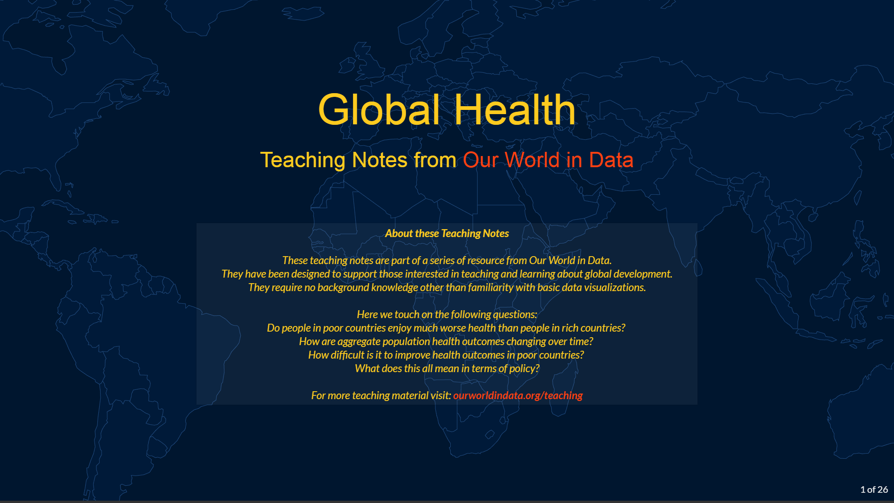

Slide 2
Outline
People in poor countries have much worse health than people in rich countries
Progress in poor countries is within our reach
What does this mean in terms of policy?

Slide 3
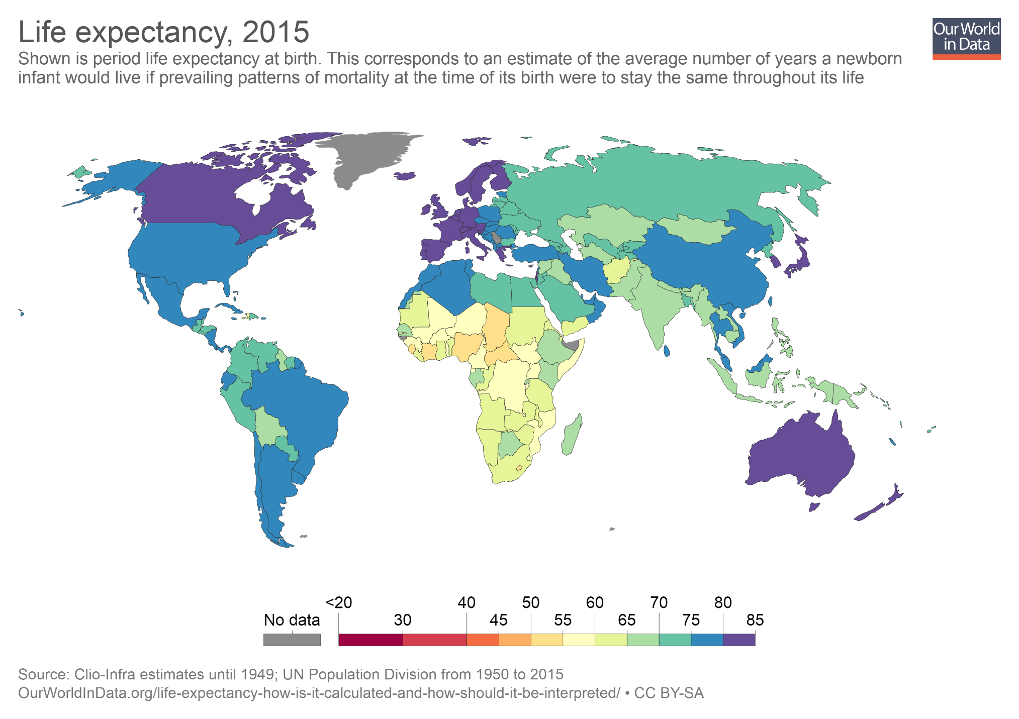
In low-income countries, the average number of years that a newborn infant can expect to live (under current mortality patterns) is much lower than in high-income countries. (Note: In the interactive version of this map you can use the slider at the bottom to show estimates for any year. And you can click on any country to plot a time series for that country.)

Slide 4
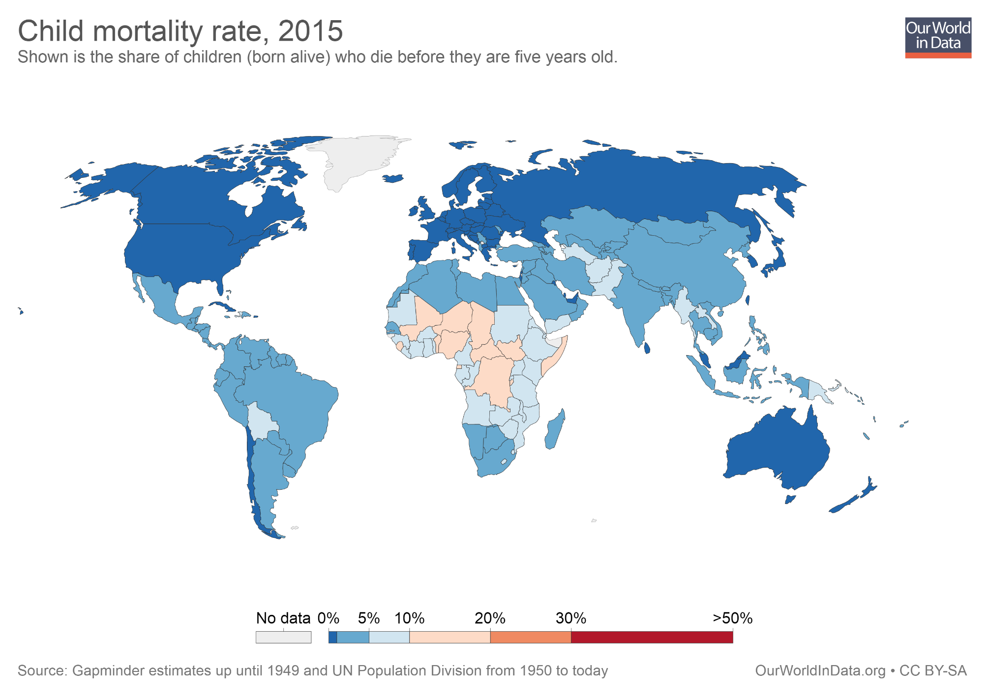
Child mortality is higher: In many low-income countries, particularly in sub-Saharan Africa, a much larger share of children die before their fifth birthday.

Slide 5
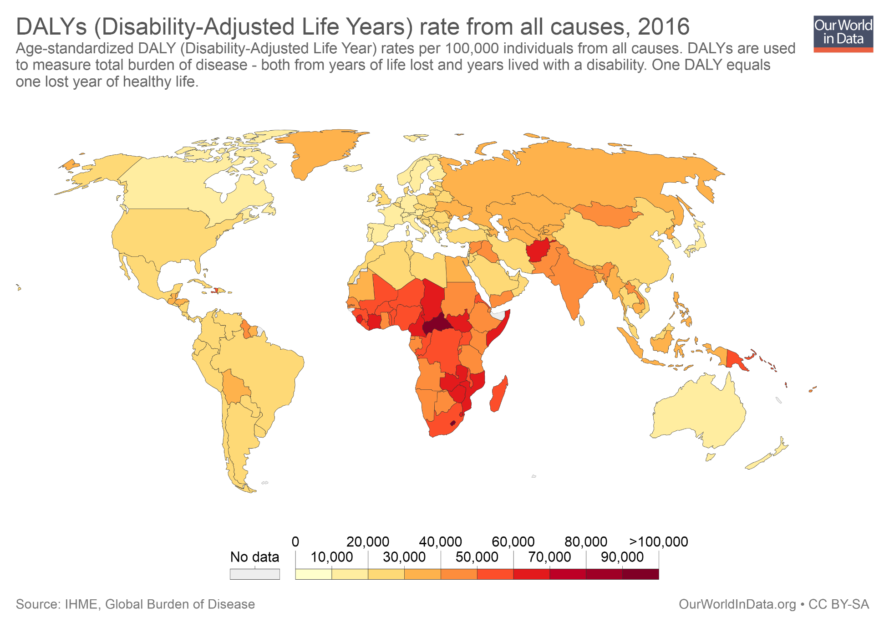
The burden of diseases is higher: If we combined data on mortality and years lived with poor health due to disability and illness, we see again that people in low-income countries tend to have much worse health outcomes.

Slide 6
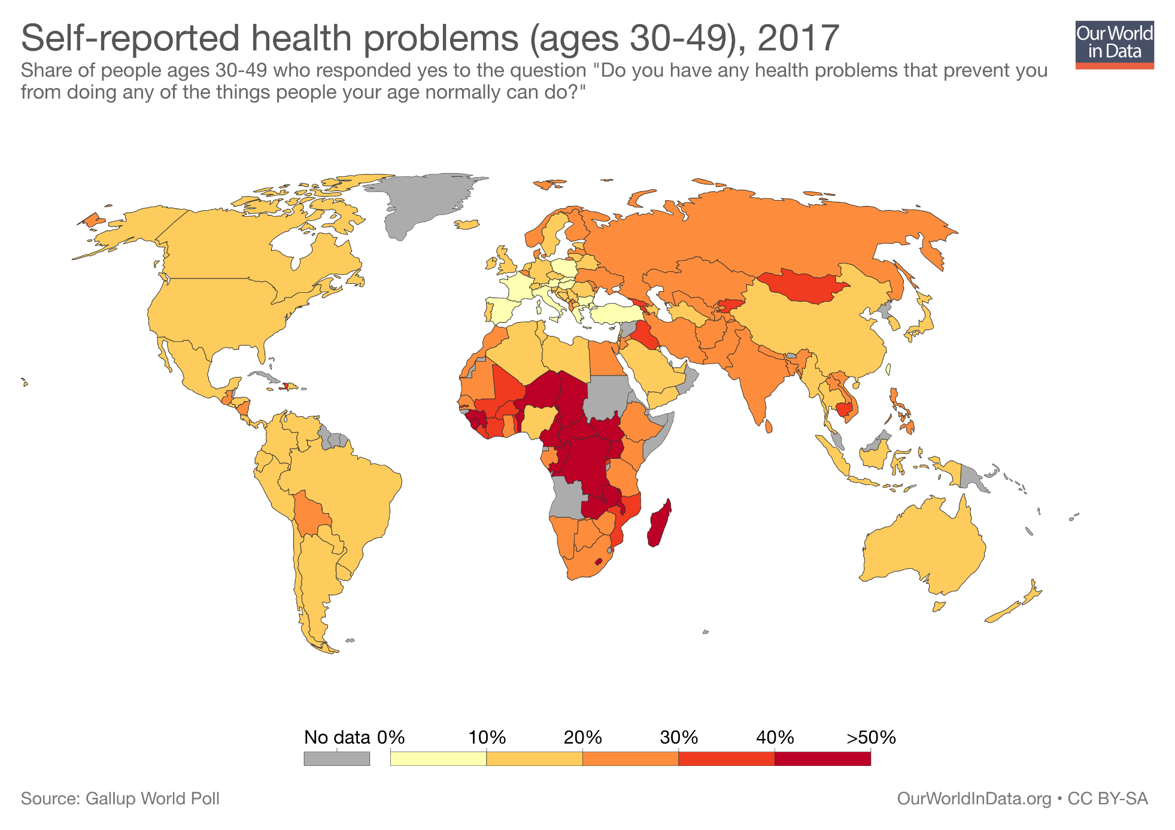
Hence, perhaps unsurprisingly, people in extreme poverty are more likely to report worse health status.

Slide 7
Outline
People in poor countries have much worse health than people in rich countries
Progress in poor countries is within our reach
What does this mean in terms of policy?

Slide 8
We have already experienced progress

Slide 9
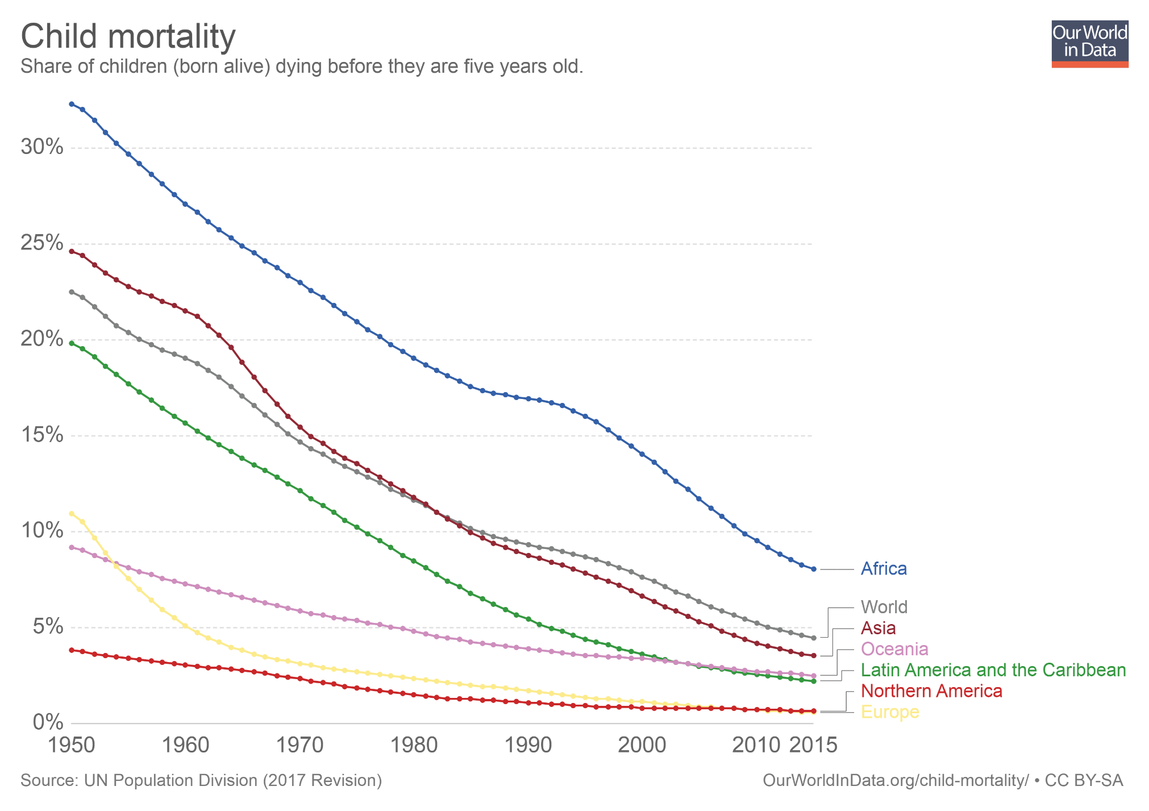
Child mortality has declined remarkably in all world regions. And since progress has been faster in the regions with the worst outcomes, we are also seeing convergence. (Note: In the interactive version of this chart you can click on the option "Add country" to plot numbers for any country or world region. You can also select the "Map" tab to show levels for all countries. )

Slide 10
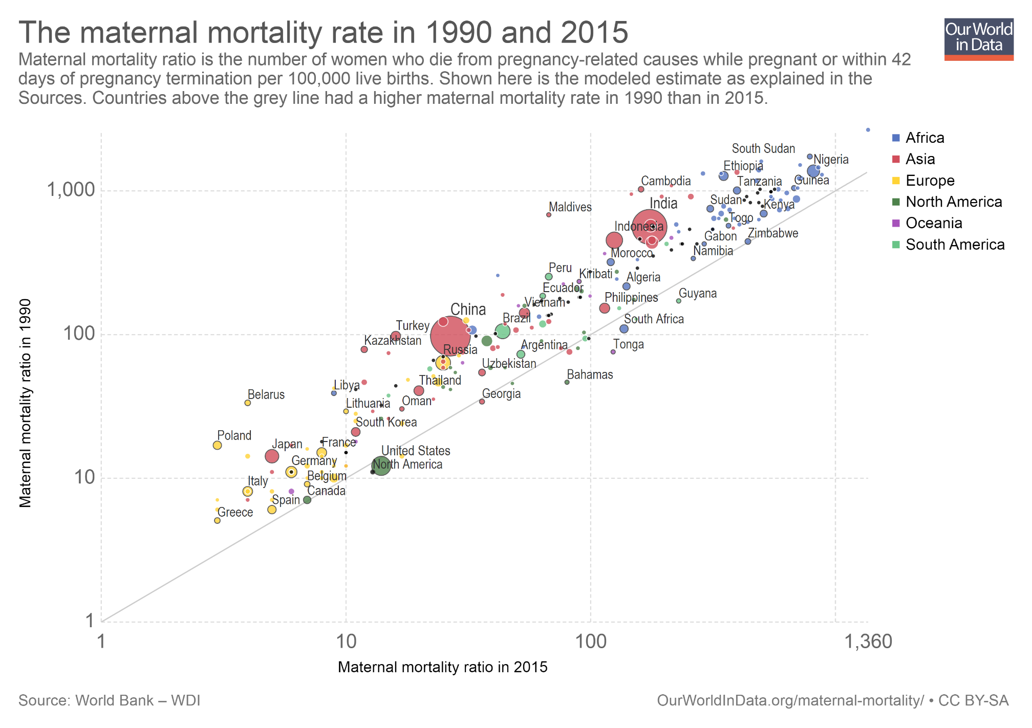
And it's not just about child mortality. Maternal mortality has also declined across the world. This chart shows the rates of maternal mortality across countries, in the years 1990 (vertical axis) and 2015 (horizontal axis). Countries above the diagonal line have seen improvements. (Note: In the interactive version of this scatter plot you can click on the continent labels on the right to highlight specific regions. And you can use the option "Search", at the bottom, to highlight specific countries.

Slide 11
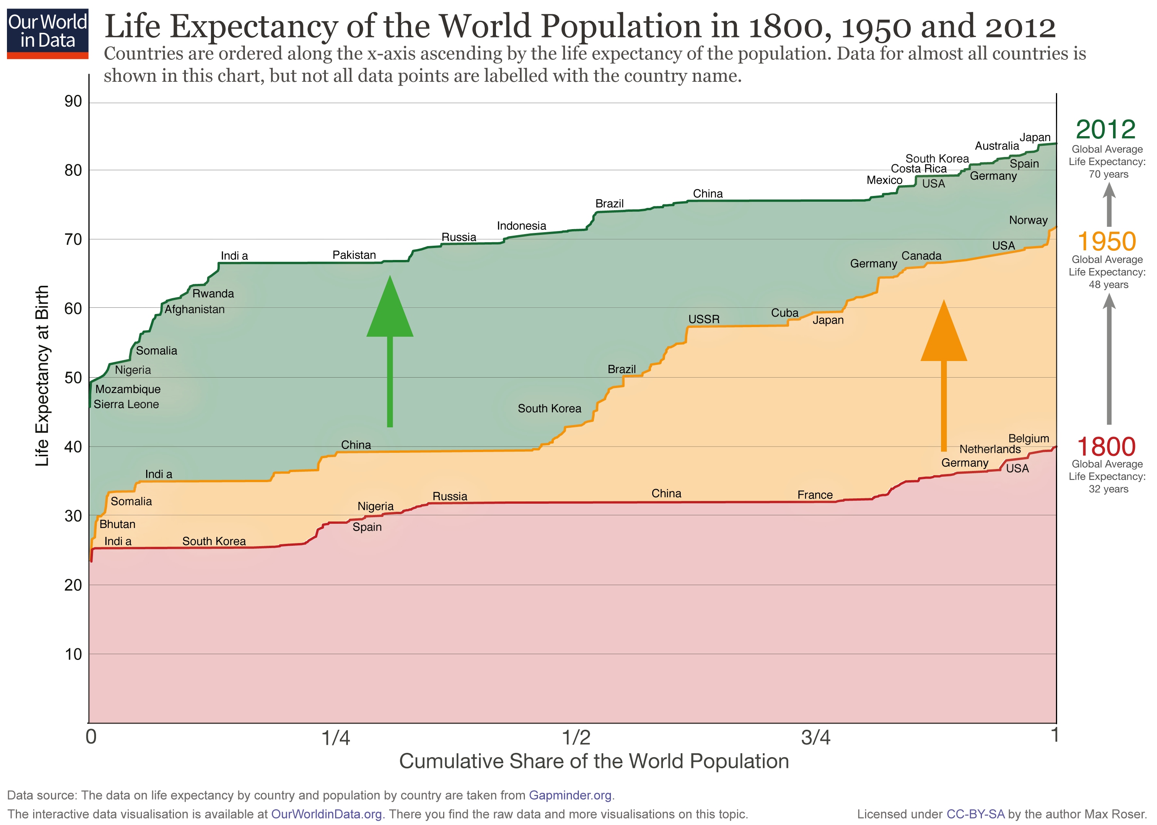
In the long run, the improvements in life expectancy have been large and global. In every country in the world people enjoy a higher life expectancy today than a century ago. (Note: In this chart the x-axis shows the cumulative share of the world population. The countries are ordered along the x-axis ascending by the life expectancy of the population.

Slide 12
Today, a large share of deaths in low-income countries can be prevented

Slide 13
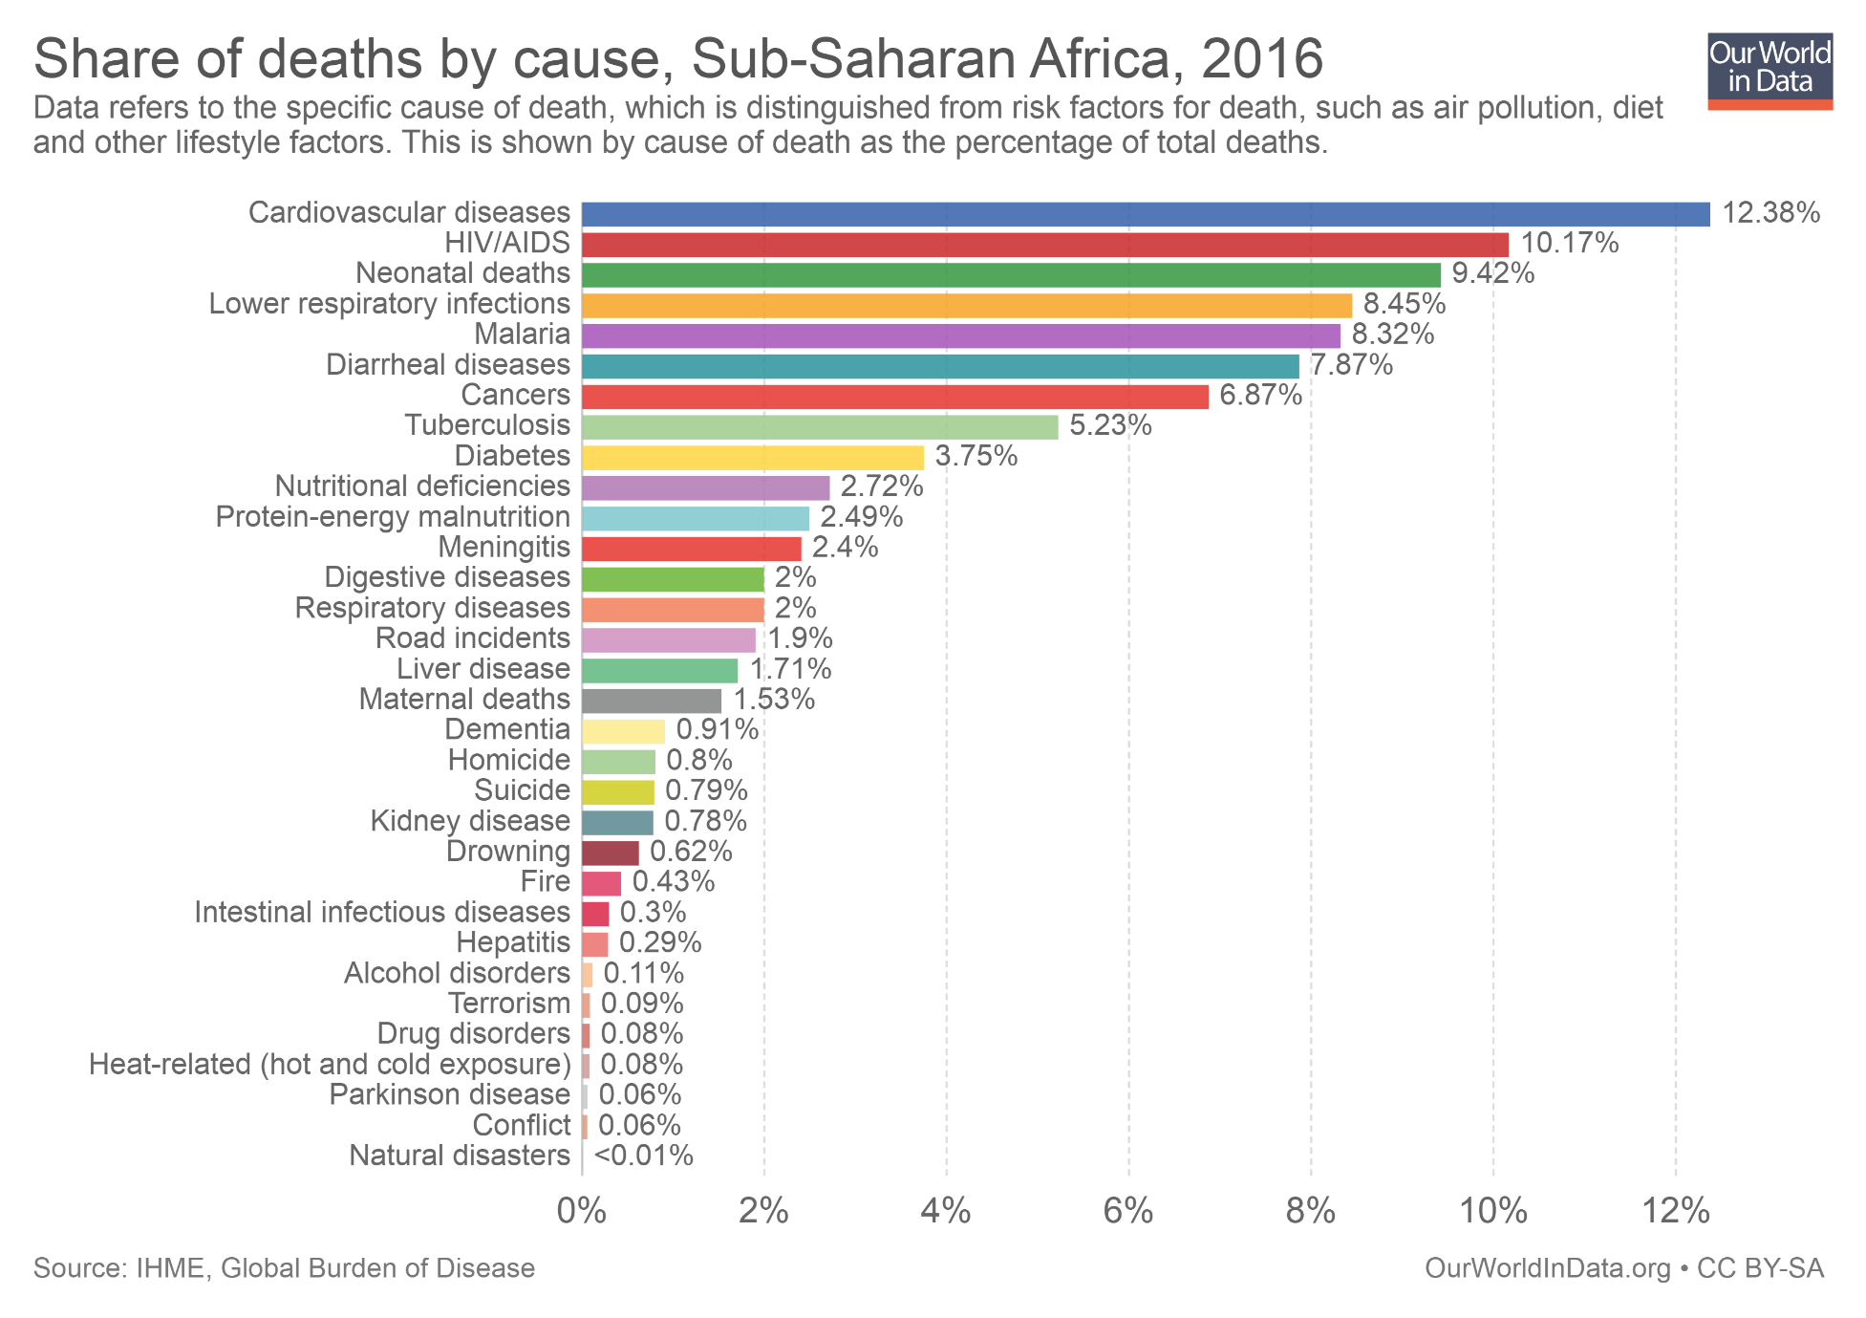
HIV/AIDS, Malaria, diarrheal diseases and conditions related to diet (malnutrition, nutritional deficiencies, etc.) are all relatively easy to prevent (and in some cases also treat). These conditions all rank high among the leading causes of death in low-income countries. (Note: In the interactive version of this chart you can use the option "Change country" to plot the same variables for any country or region.)

Slide 14
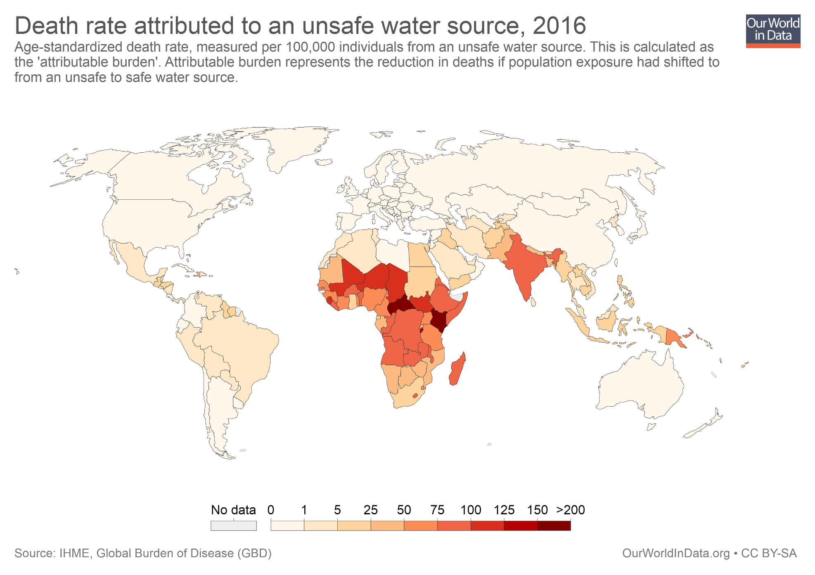
Three cheap “miracle drugs” could already save thousands of children: chlorine for purifying water; and salt and sugar, the key ingredients of rehydration solutions. Lack of access to clean water affects health even when it doesn't kill you: repeated bouts of diarrhea during childhood permanently impair both physical and cognitive development.

Slide 15
It’s not that people in extreme poverty don’t care about their health

Slide 16
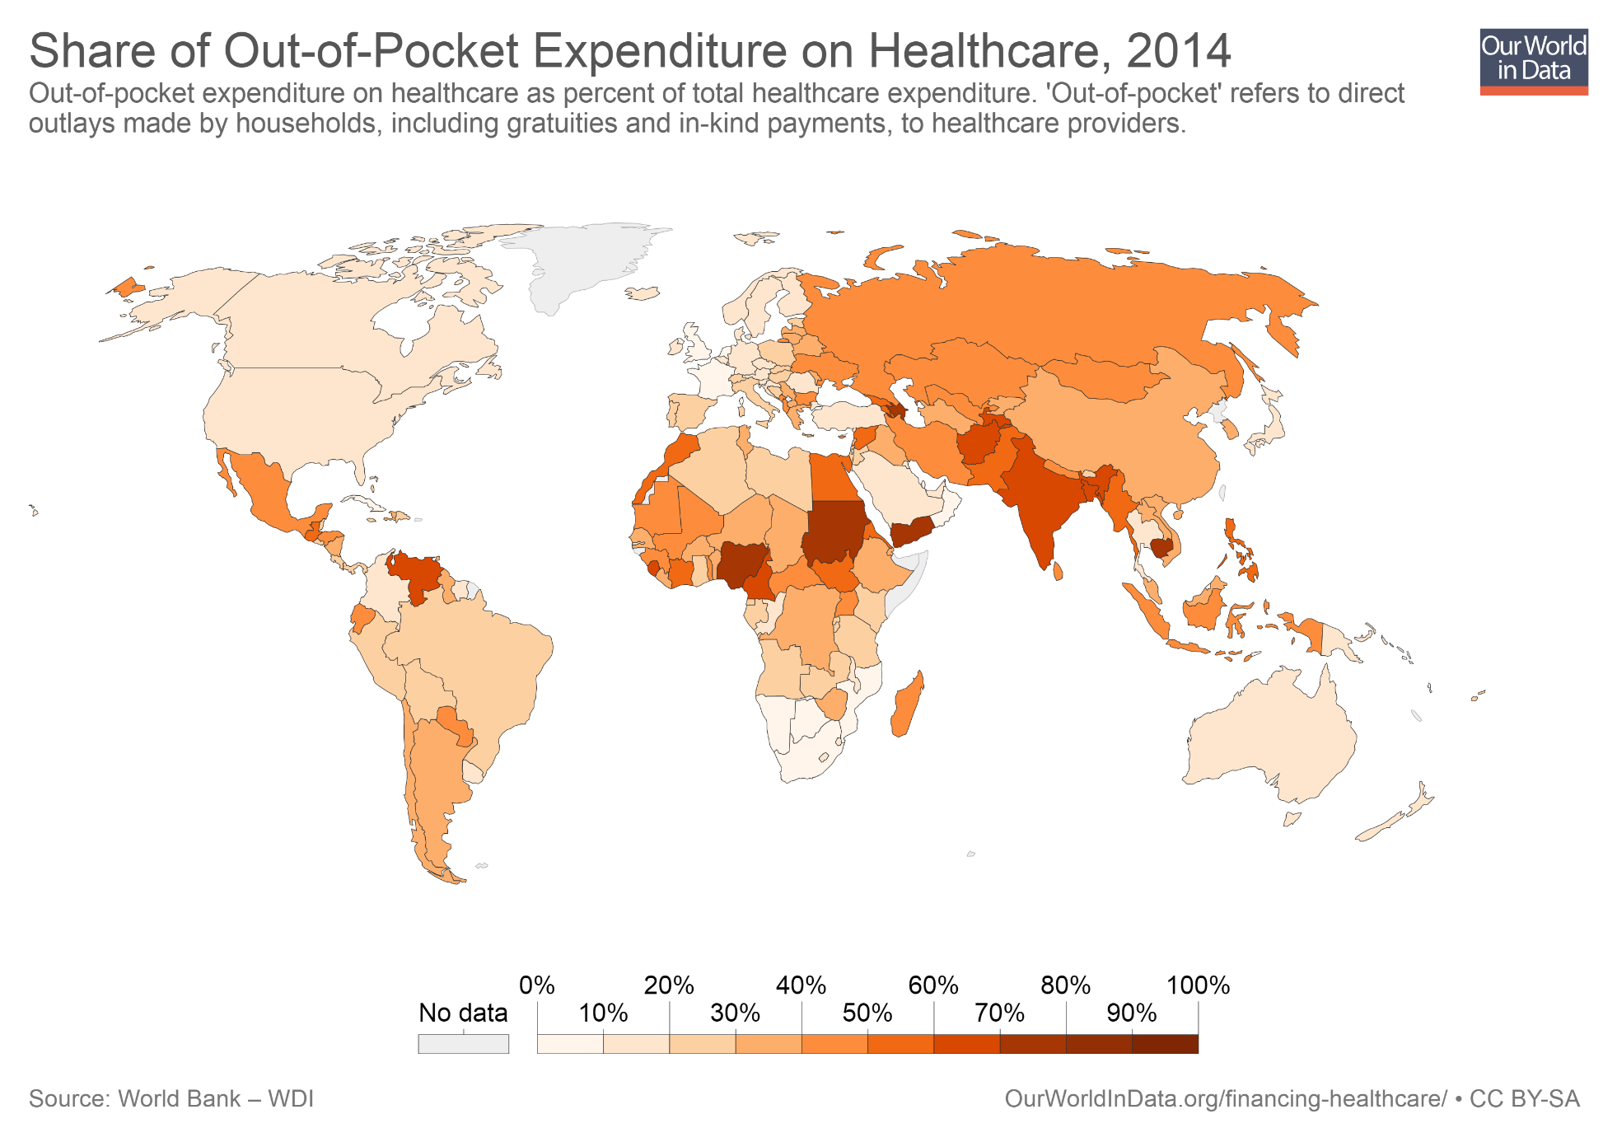
A large fraction of health care services in poor countries are purchased directly by households with 'out-of-pocket' resources. And in many countries demand for informal health care services is very large. In countries such as Nigeria, India, Bangladesh, and Thailand, health care providers without formal medical training account for between one-third and three-quarters of primary care visits.

Slide 17
There is a tendency to prefer treatment over prevention – and available treatment is often not great

Slide 18
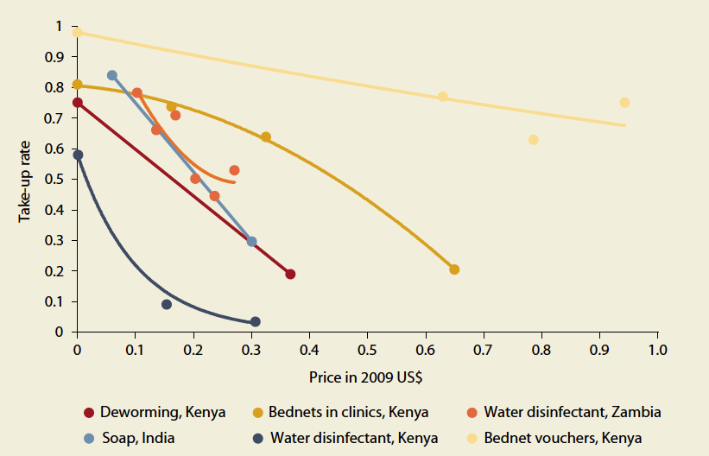
Demand for preventive health care products is very sensitive to prices, even at very low baseline prices

Slide 19
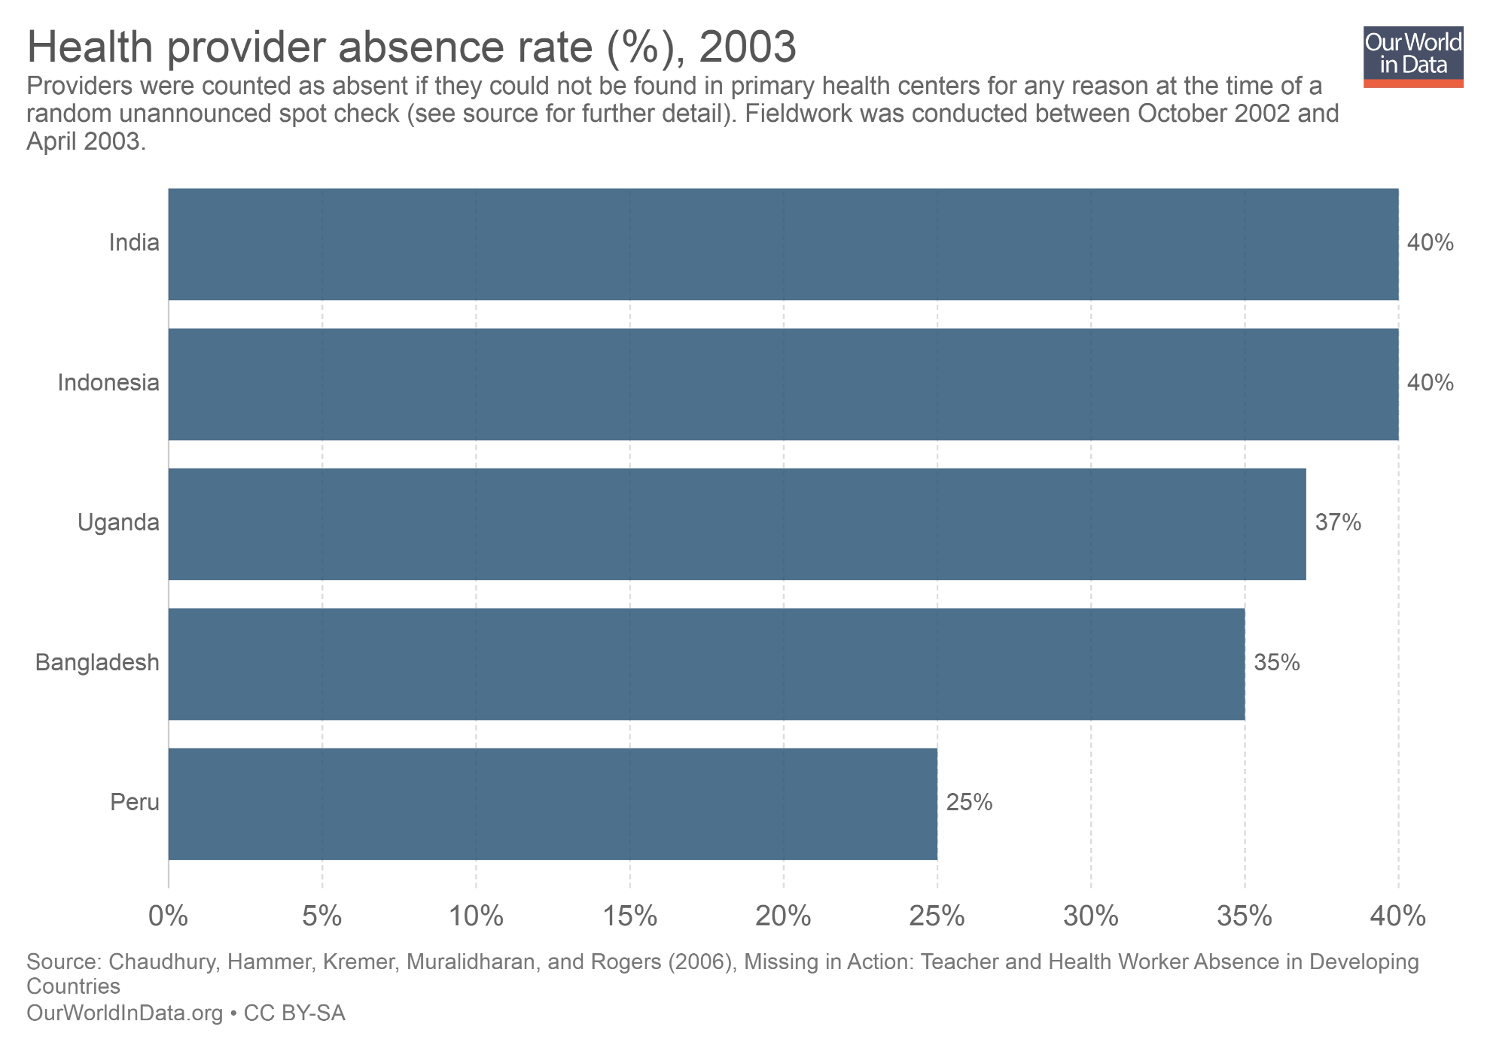
In low-income countries doctors and health providers in primary health centers are often absent from their job.

Slide 20
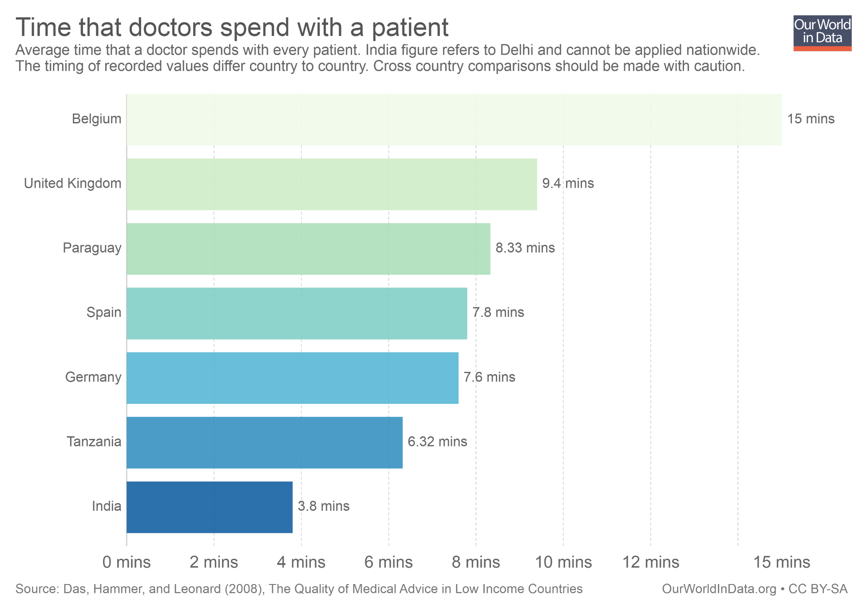
They also often spend little time with patients. And in many cases they are not qualified to do their job. In a test of medical competence for doctors in urban Delhi, a study found that in the majority of cases, formal and informal doctors would recommend a course of action that, based on the assessment of an external expert panel, was more likely to do harm than good. The unqualified private doctors were by far the worst, particularly those who worked in poor neighborhoods (Das and Hammer 2005).

Slide 21
Why demand low-quality treatment and at the same time show indifference toward preventative services?

Slide 22
Behavioural biases
Lack of information, lack of strategies to avoid procrastination, beliefs held for convenience and comfort in the absence of better alternatives
"The poor seem to be trapped by the same kinds of problems that afflict the rest of us – lack of information, weak beliefs, and procrastination among them. It is true that we who are not poor are somewhat better educated and informed, but the difference is small because, in the end, we actually know very little, and almost surely less than we imagine. Our real advantage comes from the many things that we take as given. We live in houses where clean water gets piped in—we do not need to remember to add Chlorin to the water supply every morning. The sewage goes away on its own—we do not actually know how."
(Banerjee and Duflo, Poor Economics, Page 77)

Slide 23
Outline
People in poor countries have much worse health than people in rich countries
Progress in poor countries is within our reach
What does this mean in terms of policy?

Slide 24
There is a case for subsidies, regulation, and ‘nudges’
Small incentives that nudge people to act today, rather than indefinitely postpone, can have large positive effects. Regulation of health providers and subsidies to drastically lower prices can also help substantially.
"We should recognize that no one is wise, patient, or knowledgeable enough to be fully responsible for making the right decisions for his or her own health. For the same reason that those who live in rich countries live a life surrounded by invisible nudges, the primary goal of health-care policy in poor countries should be to make it as easy as possible for the poor to obtain preventive care, while at the same time regulating the quality of treatment that people can get.“
(Banerjee and Duflo, Poor Economics, Page 78)

Slide 25
Further Resources from Our World in Data
Blog posts and data entries on this topic: – ourworldindata.org/life-expectancy – ourworldindata.org/child-mortality – ourworldindata.org/maternal-mortality – ourworldindata.org/causes-of-death – ourworldindata.org/burden-of-disease – ourworldindata.org/malaria – ourworldindata.org/health-meta
Reading list and Teaching Notes for other topics: – ourworldindata.org/teaching

Slide 26
About the author: Esteban Ortiz-Ospina is an economist at the University of Oxford. He is a Senior Researcher at the Oxford Martin Programme on Global Development.
About Our World in Data: Our World in Data is an online publication that shows how living conditions are changing. The aim is to give a global overview and to show changes over the very long run, so that we can see where we are coming from, where we are today, and what is possible for the future.
www.ourworldindata.org/about | @eortizospina

